Slide 1







C limate A nalytics
L ab
Accelerating climate science with machine learning: Earth system emulation
Duncan Watson-Parris, Scripps / HDSI (UC San Diego)
Computational and Information Systems Lab, NSF NCAR
15th February 2024

Slide 2
Overview
Introduction
Climate model emulation:
For improved UQ and calibration
For exploring future climate
For modelling spatio-temporal noise
Outlook and future work

Slide 3


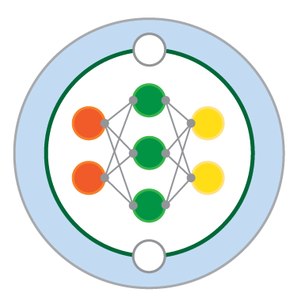










Machine Learning
Notes:
Machine learning has been around for a long time but has recently exploded in popularity due to some very high profile success stories...
Spurred many large research efforts, and many more smaller ones, looking at pretty much every aspect of climate science.
27 virtual seminars through AI for good plus a recent summit
It’s an exciting time and people are tying a lot of things out – it’s very exploratory.
This isn’t magi, It is just a tool, that requires thought about how it is used and how the results should be interpreted. I expect there will be a period of consolidation at some point.
Despite that there have already been some successes, and while NVIDIA and others are making big strides in emulating weather models, in some respects emulating the climate is simpler. If you’re just interested in the steady state response to a boundary condition perturbation you don’t have to emulate the full dynamics..

Slide 4

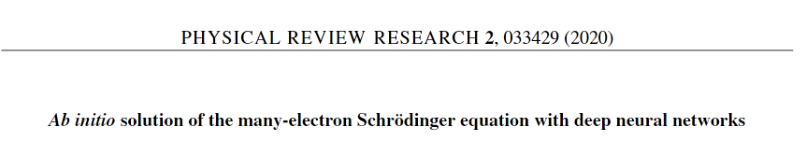
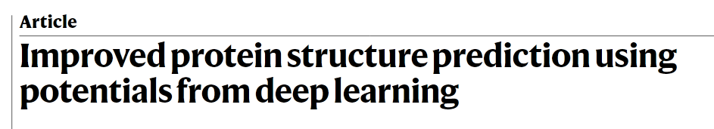




Machine Learning
Notes:
Machine learning has been around for a long time but has recently exploded in popularity due to some very high profile success stories...

Slide 5
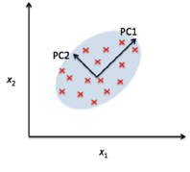
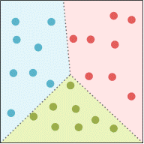
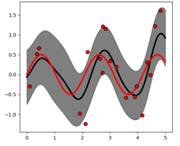
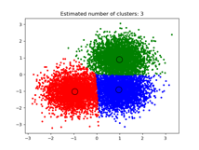
Machine Learning
Dimensionality reduction
Semi-supervised
Classification
Generative models
Unsupervised
Supervised
Regression
Clustering
Reinforcement
Notes:
What do I mean by machine learning?
Really only an extension of many of the same techniques we have been using for a long time
Key difference is the dimensionality of the inputs and outputs which leads to challenges in terms of optimisation and over fitting
In this talk I will focus on regression

Slide 6

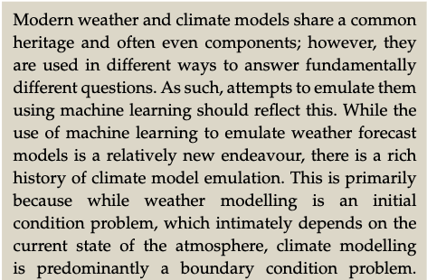
Watson-Parris 2021
Notes:
First like to make clear an important distinction between modelling the weather and climate (either physical or with ML), which I point out in this recent perspective paper…

Slide 7
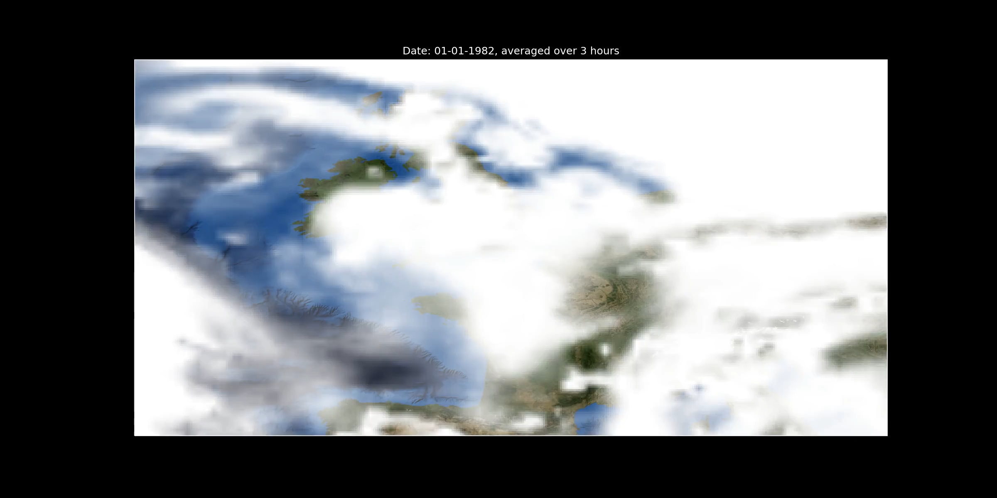
ML for Weather and Climate are worlds apart
c.f. Watson-Parris 2021
Notes:
The atmosphere is a beautiful chaotic system, and the accuracy of our weather forecasts is crucially dependent on good observations of the present state
Whereas over larger spatial and temporal scales … boundary condition problem where the ultimate boundary is given by the balance of radiation at the top of the atmosphere.
The point is that we don’t have to emulate the full dynamical evolution of the system in order to emulate the climate response.

Slide 8

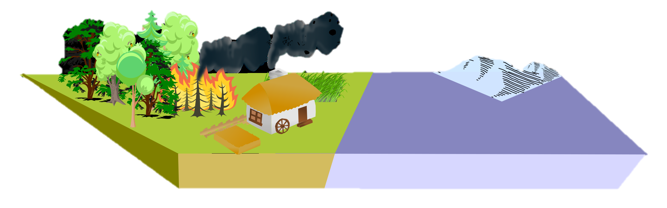
Natural aerosol
Pre-industrial
After Bellouin et al. Rev. Geophysics (2019)
Notes:
The key boundary condition perturbation that I’m interested in is due to changes in aerosol
Aerosol in the atmosphere can come from many sources such as dust, sea salt and also natural wildfires.
They vary in size... up to around a micron in size and so only stay in the atmosphere for a few days, so they have quite complex distributions.
They can scatter and absorb incoming solar radiation ,
but one really important role they have is providing the nuclei on which cloud droplets form…
When a cloud rains this aerosol is removed from the atmosphere (mostly by whe particles in the rain, but also by washing the air through which it passes)

Slide 9

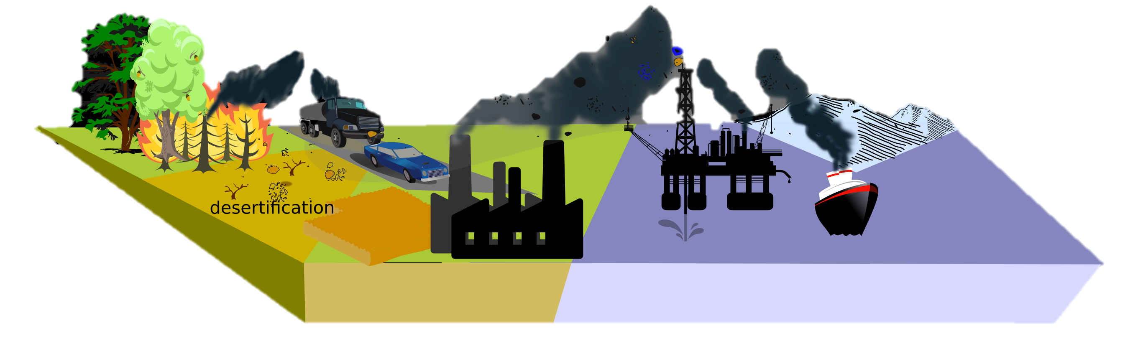
Aerosol Forcing
Present day
After Bellouin et al. Rev. Geophysics (2019)
Notes:
Now, in the present day, there are a large number of anthropogenic aerosol sources, primarily burning dirty fossil fuels, but also crop clearing and other land changes. These interact in complex ways with the existing aerosol, and generally act to increase the amount of sunlight that is reflected back to space, inducing a forcing.
The other thing you will have noticed changed was that now we have more aerosol, assuming the amount of water stays the same, then we tend to get more, smaller cloud droplets. This makes the cloud brighter and provides another cooling on the planet.
Furthermore, these smaller droplets can reduce precipitation and potentially increase the lifetime of clouds – which induces another cooling. Generally speaking the further down this chain of processes we go, the larger the potential cooling affect but the larger the uncertainties

Slide 10
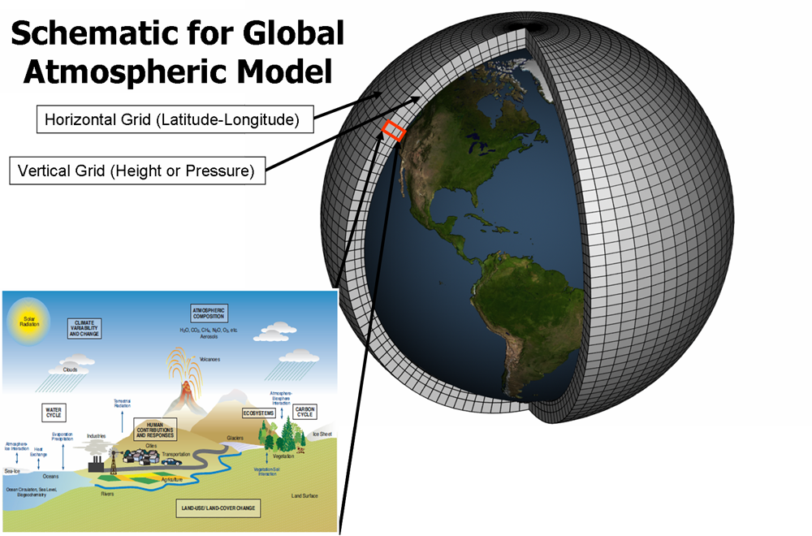
Climate models
Notes:
In order to get a global measure of forcing we require…
Need to be parameterised blah blah
Fundaemntal source of uncertainty…

Slide 11
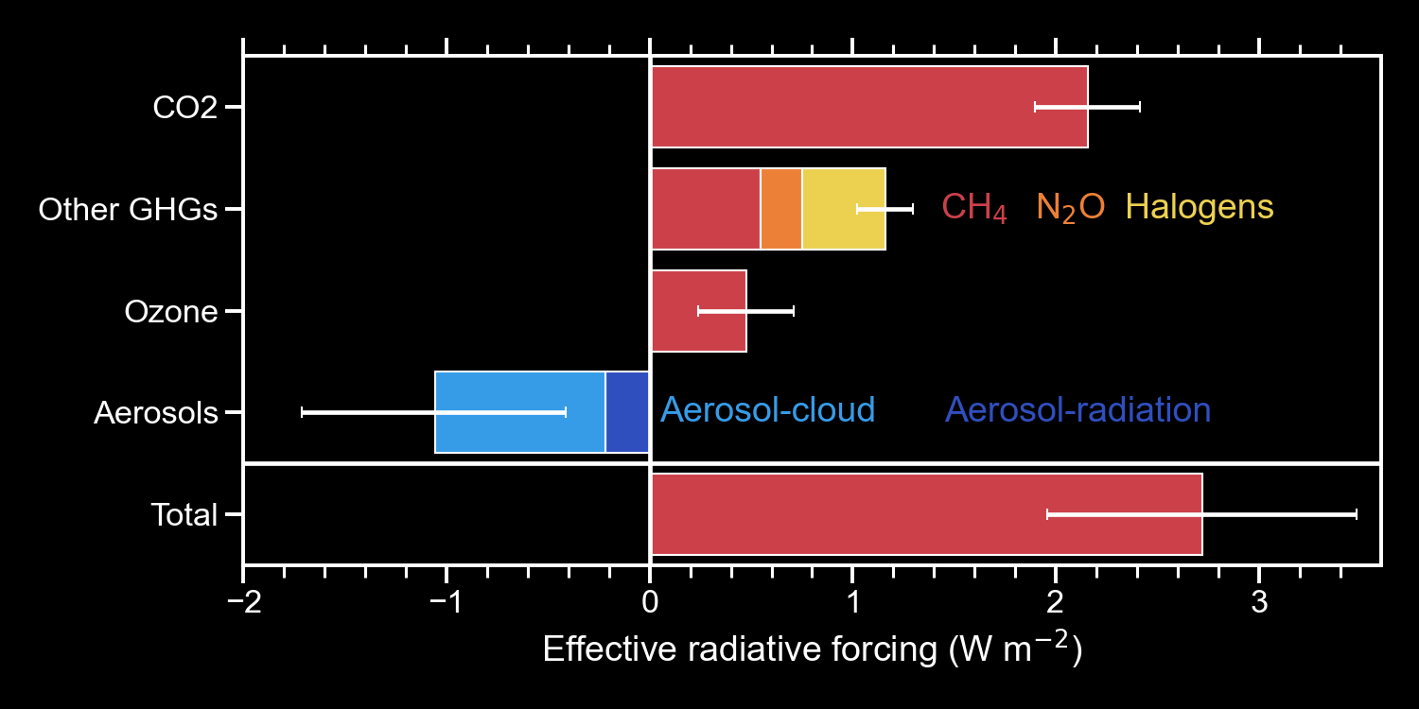
Anthropogenic Forcing Uncertainty
Adapted from IPCC AR6
Notes:
So if we look at the various different anthropogenic forcings…
Aerosol forcing stands out as the only negative contribution, and the most uncertain
Now this talk of forcing might sound a bit esoteric, but it has important implications

Slide 12
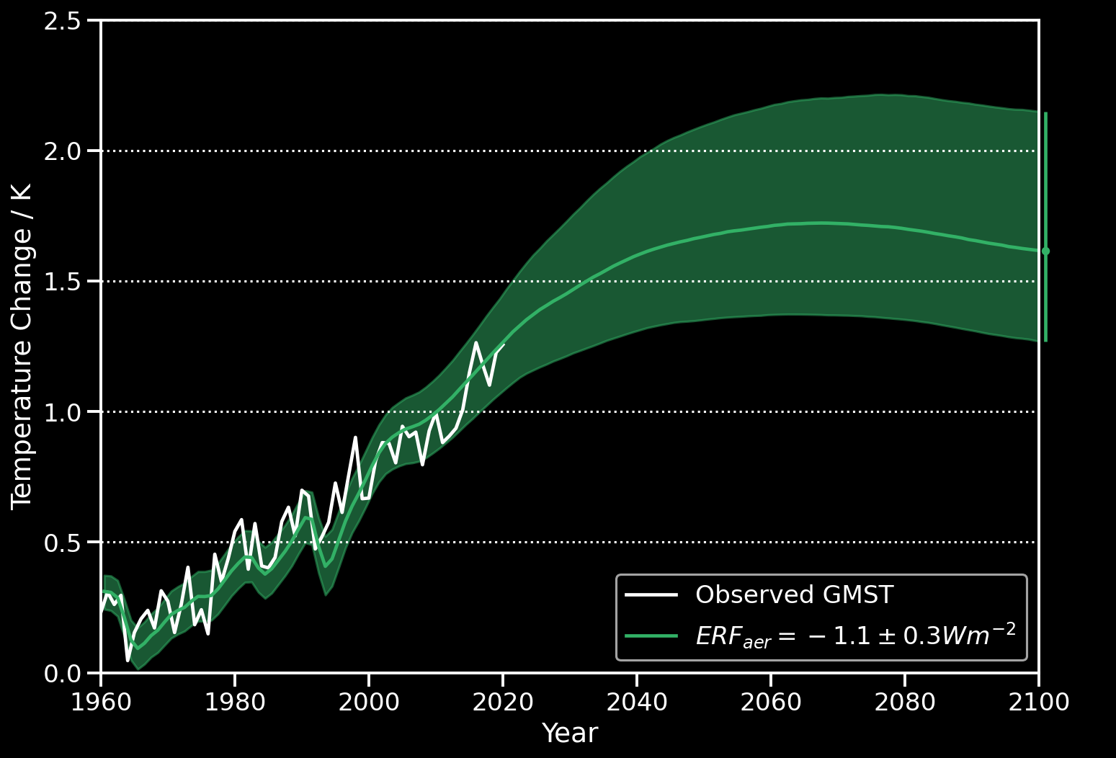
Uncertain Aerosol Forcing -
Uncertain Climate Projections
Watson-Parris & Smith Nature Clim. Change (Accepted)
Notes:
Climate projections are essential for determining how best to mitigate or adapt to climate change, but are frustratingly uncertain, even for a single scenario shown here (SSP126). This is sampled from the IPCC AR6 assessed probabilities and the large uncertainty hinders the ability of policy-makers to plan future transitions.

Slide 13
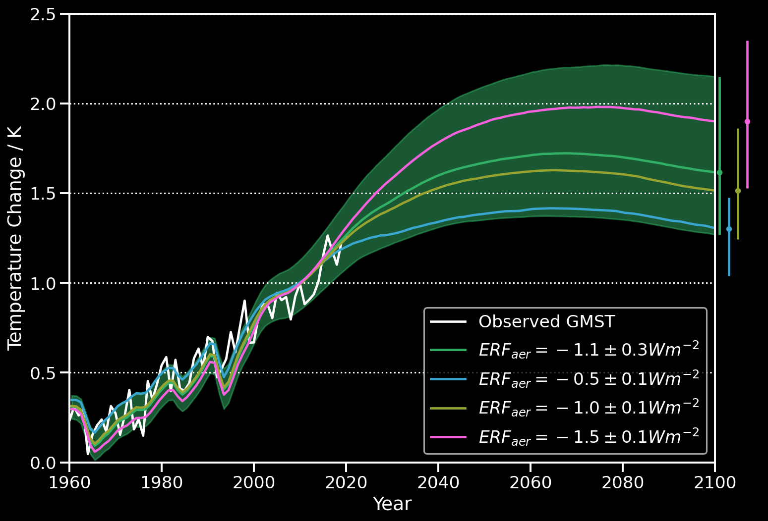
Uncertain Aerosol Forcing -
Uncertain Climate Projections
Watson-Parris & Smith Nature Clim. Change (Accepted)
Notes:
I mentioned the role of aerosol in present day warming uncertainty in my research statement, but Aerosol forcing contributes a large fraction of this future uncertainty too, especially for these high ambition pathways.
For context, this 0.5 degree of warming is worth $10 trillion in avoided damages by 2050
Also the difference between ‘medium’ risk of extreme weather events and ‘high’ (indicating severe and widespread impacts/risks ) According to SR15

Slide 14
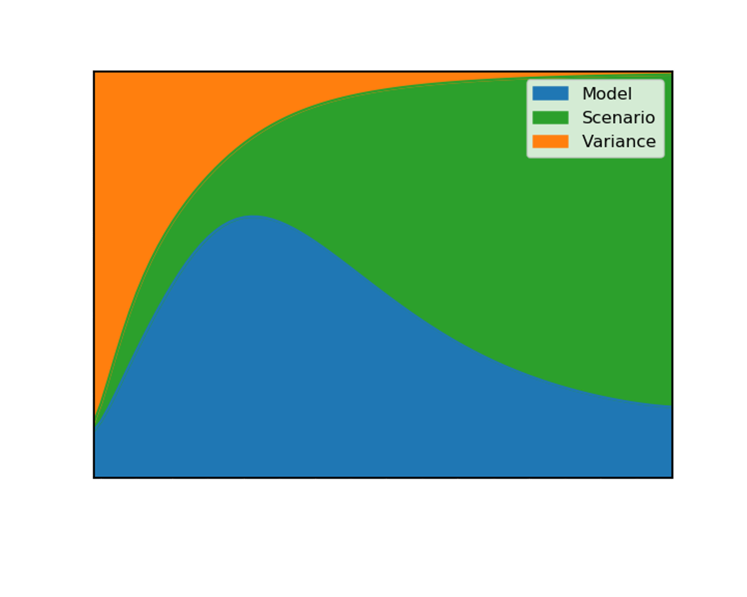
Sources of uncertainty
Watson-Parris 2021
After Hawkins & Sutton 2009
Notes:
So having convinced you of that – what are the main uncertainties in climate projections?

Slide 15
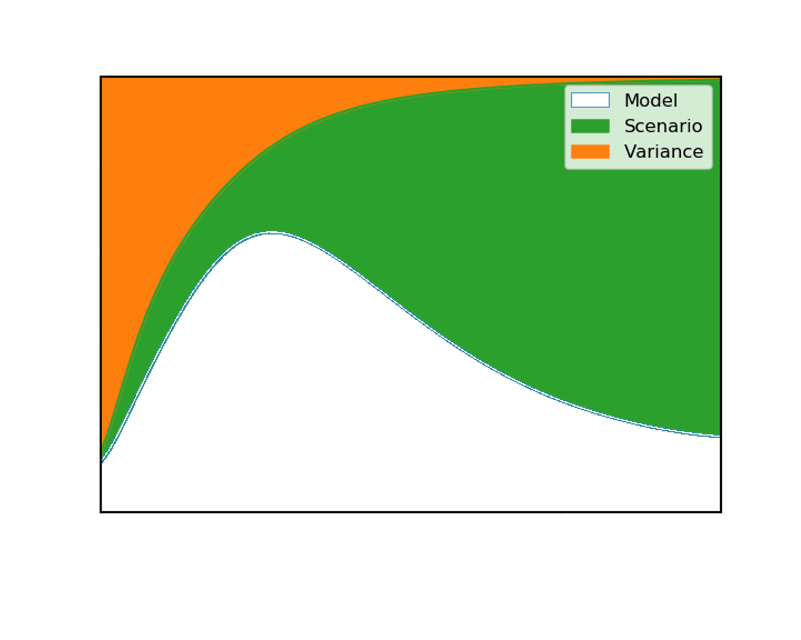
Sources of uncertainty
Watson-Parris 2021

Slide 16
Climate model emulation for calibration
Notes:
Maybe ask for any questions here

Slide 17
Climate model emulation
Representation power
Deep networks
Random forests
GP emulation
Linear Regression
Too simple
Clustering
Physical loss
Interpretability
Bias correction
Lack of flexibility
Parameter estimation
Physical Structure
After Beucler et al. 2020
Notes:
This can broadly apply to individual components, or the whole model. Some groups are focussing on using emulation as an optimisation technique where other considerations might be important. Here I want to focus on parameter estimation.

Slide 18

Exploring parametric uncertainty
A climate model is a function $ℱ$ of input forcers $X$ and parameters $θ$ and generates outputs $Y$: $ℱ\left(X,θ\right)=Y$.
Given a set of observations of $Y$, denoted $Y^{0}$, we would like to calculate the inverse: $ℱ^{−1}\left(Y^{0}\right)=θ$.
Or, more precisely, we would like to know the posterior probability distribution of the input parameters:
$$p\left(θ | Y^{0}\right)=\frac{p\left(Y^{0} | θ\right)p(θ)}{p(Y^{0})}$$
Notes:
This can broadly apply to individual components, or the whole model. Some groups are focussing on using emulation as an optimisation technique where other considerations might be important. Here I want to focus on parameter estimation.

Slide 19

Likelihood-free inference
We cannot compute the full likelihood but can approximate it using Approximate Bayesian computation (ABC; or rejection sampling):
Draw $θ$ from$p(θ)$
Calculate $ℱ\left(θ\right)$ to determine $Y$
Accept $θ$ if $ρ\left(Y^{0},Y\right)≤ε$
As $ε→∞$, we get observations from the prior, $p(θ)$
As $ε→0$, we generate observations from $p\left(θ | Y^{0}\right)$
In practice we need many, many samples and so a surrogate model, or emulator, is used: $ℰ\left(θ\right)\sim ℱ\left(θ\right)$
Notes:
This can broadly apply to individual components, or the whole model. Some groups are focussing on using emulation as an optimisation technique where other considerations might be important. Here I want to focus on parameter estimation.

Slide 20

Implausibility
In practice, we need to define the distance, $ρ\left(Y^{0},Y\right)$
We use the concept of an implausibility metric:
Assuming this distribution is unimodal, we can then use the 3σ to rule out parameter combinations at 95% confidence
Observation
$$I\left(θ\right)= \frac{\left|Y^{0}−E\left[η\left(θ\right)\right] \right|}{\sqrt{\left[Var\left(φ\left(θ\right)\right)+Var\left(ε\right)+Var\left(δ\right)\right]}}$$
Model output
[Prediction from emulator]
Emulator prediction uncertainty
Observational uncertainty
Structural uncertainty
Vernon et al. 2010
Notes:
Important opportunities here to link to dimensionality reduction and spatio-temporal modelling

Slide 21
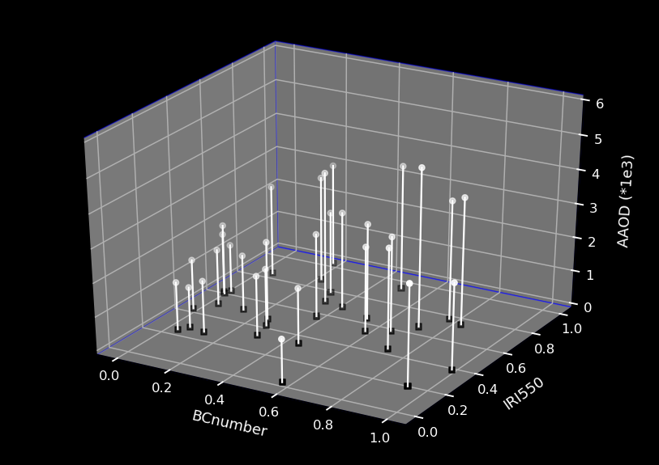
Emulation

Slide 22
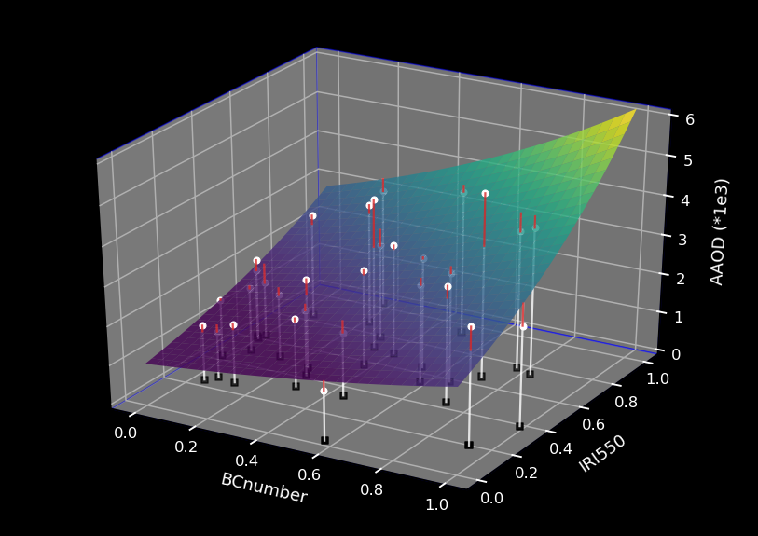
Emulation

Slide 23
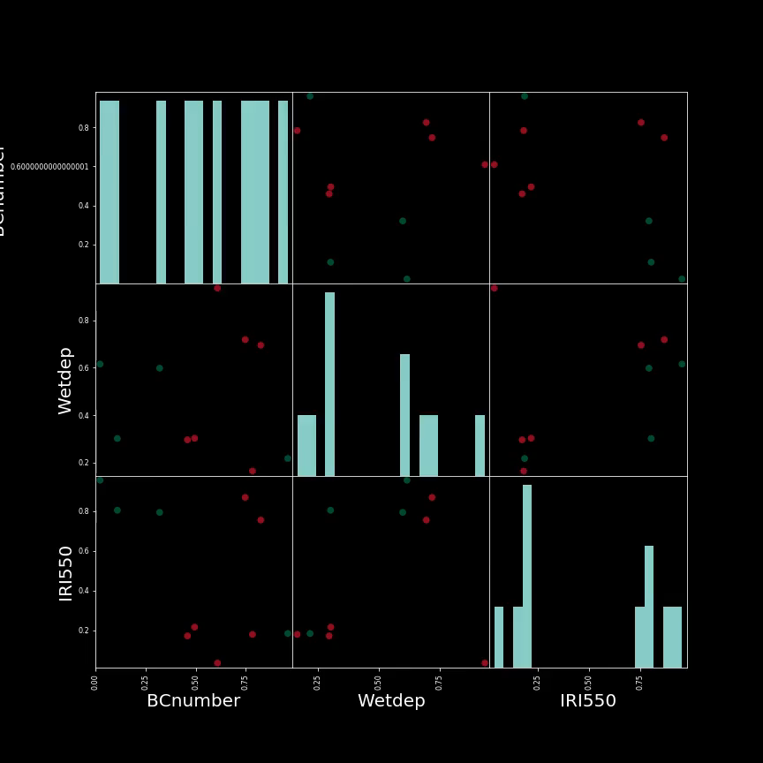
Sampling

Slide 24




Earth System Emulator (ESEm)
Model data
Validation
Data fusion /
collocation
Training
Emulation
Validation
Model data
Observed data
Inference / Calibration
ABC in TensorFlow
CIS
ESEm
Watson-Parris et al. GMD 2021
Watson-Parris et al. GMD 2016

Slide 25
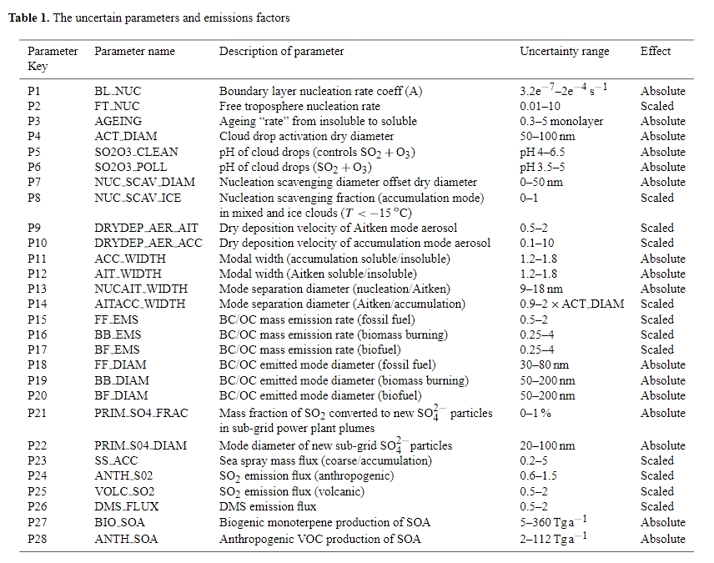
Parametric uncertainty
Lee et al. 2013.

Slide 26
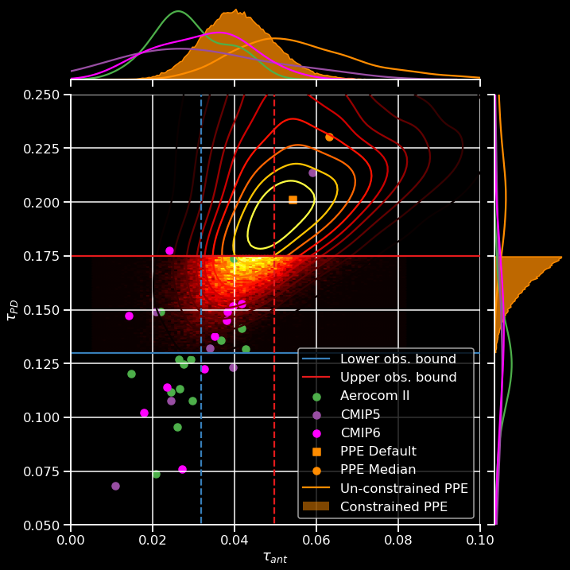
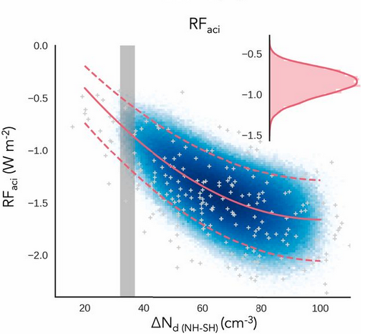
Constraining parametric uncertainty
Watson-Parris et al. 2020
McCoy et al. 2020
Notes:
While we are now able to do this in individual models, how can we bring in more observations and what about multiple models..
For example what happens if we explore the full spread around one of these dots?... MMPPEs

Slide 27
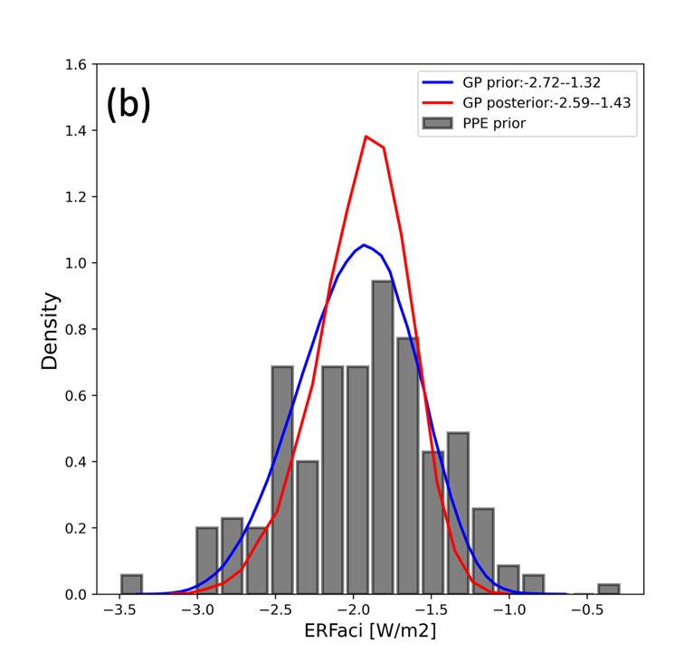
Constraining parametric uncertainty
CAM6
Song et al. submitted.
Notes:
While we are now able to do this in individual models, how can we bring in more observations and what about multiple models..
For example what happens if we explore the full spread around one of these dots?

Slide 28
Constraining parametric uncertainty
CAM6
UKESM
Song et al. submitted.
Regayre et al. ACP 2023
Notes:
While we are now able to do this in individual models, how can we bring in more observations and what about multiple models..
For example what happens if we explore the full spread around one of these dots?

Slide 29
Constraining parametric uncertainty
CAM6
UKESM
Song et al. submitted.
Regayre et al. ACP 2023
Notes:
While we are now able to do this in individual models, how can we bring in more observations and what about multiple models..
For example what happens if we explore the full spread around one of these dots?

Slide 30
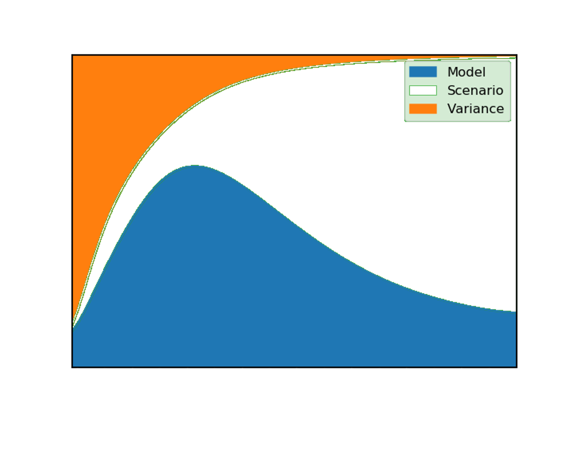
Sources of uncertainty
Watson-Parris 2021

Slide 31
Exploring future climates with ClimateBench
Notes:
What if the structural parameterisation is just wrong though? Can we infer the response of clouds to aerosol directly from observations?
We can then use this improved physics knowledge to test and improve our parameterisations.
I don’t want to suggest replacing parameterisations with this I don’t think

Slide 32
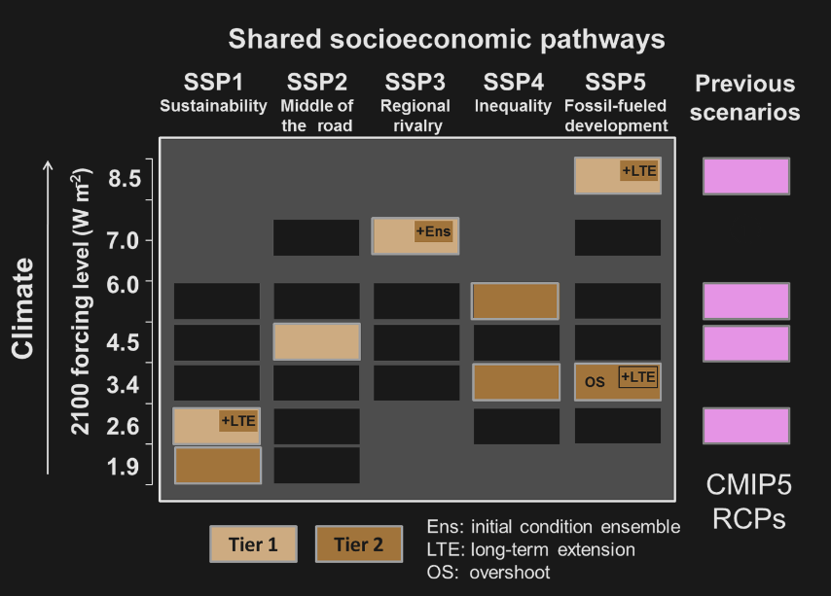
Climate projections: ScenarioMIP
Notes:
Many of you are very familiar with the ScenarioMIP simulations that were chosen to sample different socio-economic scenarios and span broad range of 2100 forcing.
This sampling is clearly very sparse even in this much simplified two-dimensional view of the problem and so for policy purposes emulators are used to explore the many different possible pathways

Slide 33
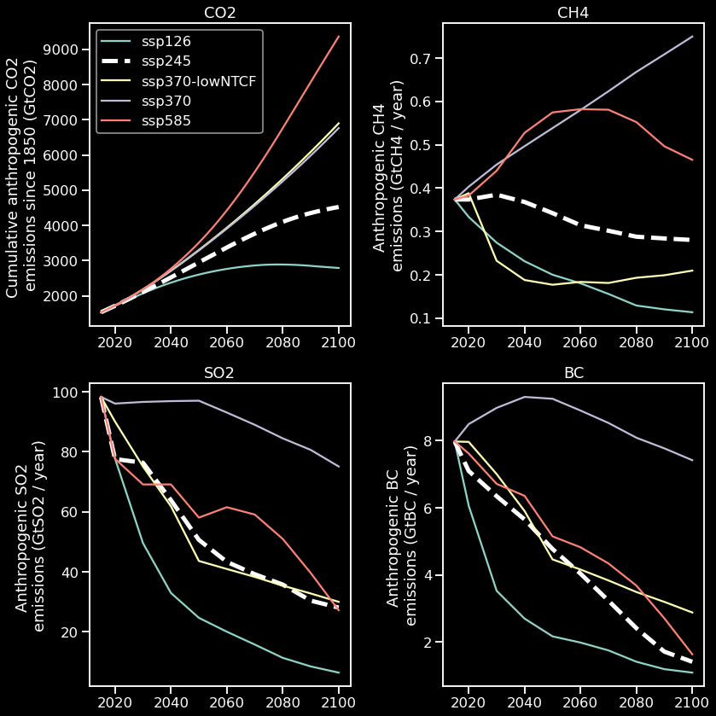
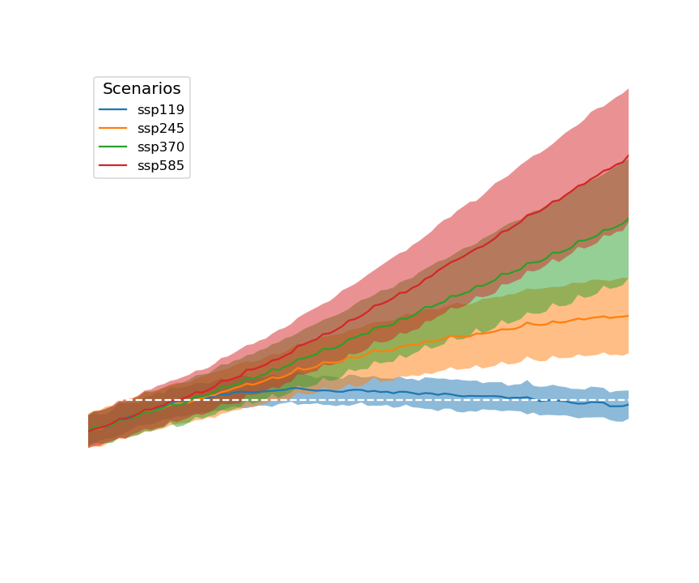

Exploring scenario uncertainty: (Simple) Emulators
Emulate $\left|ℱ\left(X,θ\right)\right|$
E.g., FAIR, MAGGIC, WASP etc.
Notes:
These simple emulators take …
They have been used for a long time and formed an important part of the latest IPCC WG1 report and will link the WG1 findings to the upcoming WG2 and 3 reports

Slide 34
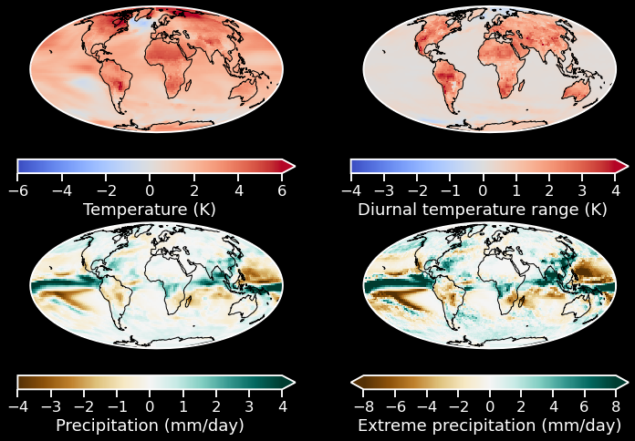
Exploring scenario uncertainty:
Pattern Scaling
Emulate $\left|ℱ\left(X,θ\right)\right|$
E.g., MESMER
Notes:
There are also approaches to turn these in to spatially resolved maps of temperature change, with some now using ML approaches such as MESMER
Only temperature though and no regional effects of aerosol emissions

Slide 35
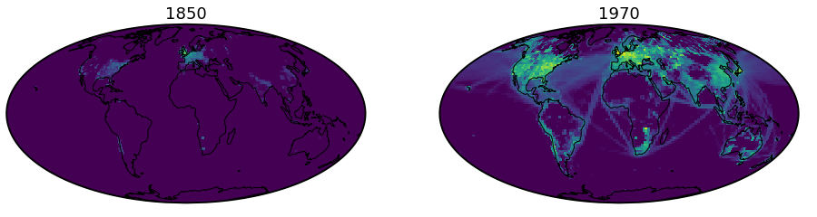

Exploring scenario uncertainty: ClimateBench
Emulate $ℱ\left(X,θ\right)$
Spatially resolved emissions of SO2 and BC
1850
2020
Watson-Parris et al. JAMES (2022)
Notes:
Inspired by WeatherBench I made ClimateBench – the first benchmark dataset for climate model emulation

Slide 36
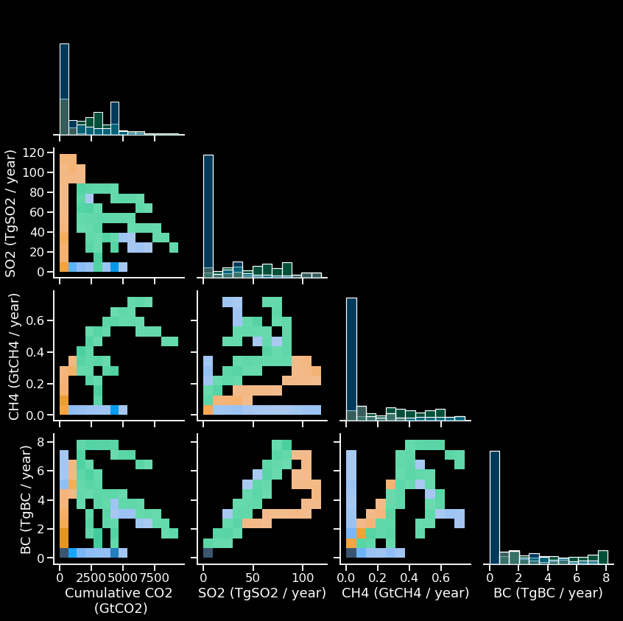

ClimateBench training dataset
Pre-processed input4MIPS inputs and NorESM2 outputs for multiple experiments
Selection of future socio-economic pathways designed to span range of likely future scenarios
Two idealised simulations modelling the effect of abrupt and gradual increases in CO2
Core historical experiment plus two detection and attribution simulations of the historical period with either aerosol or GHG held constant
Together they do a good job of spanning the input space – although aerosol species are correlated
Seland et al. 2020

Slide 37
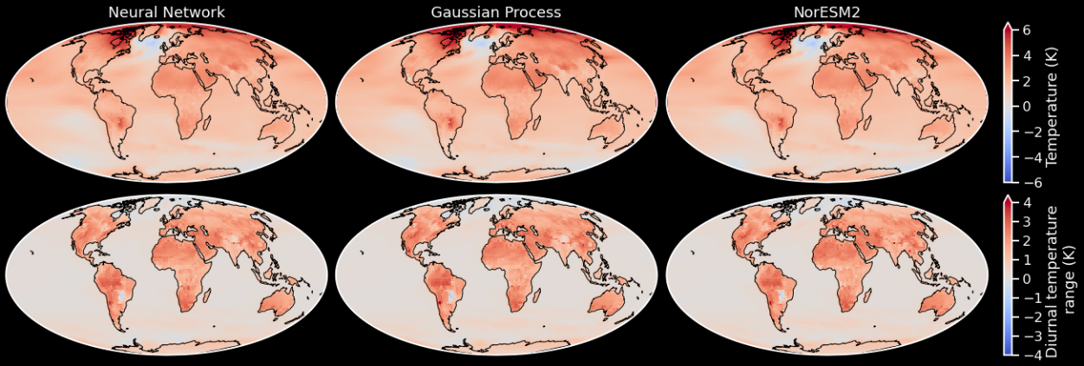
Baseline Models
Watson-Parris et al. JAMES (2022)

Slide 38
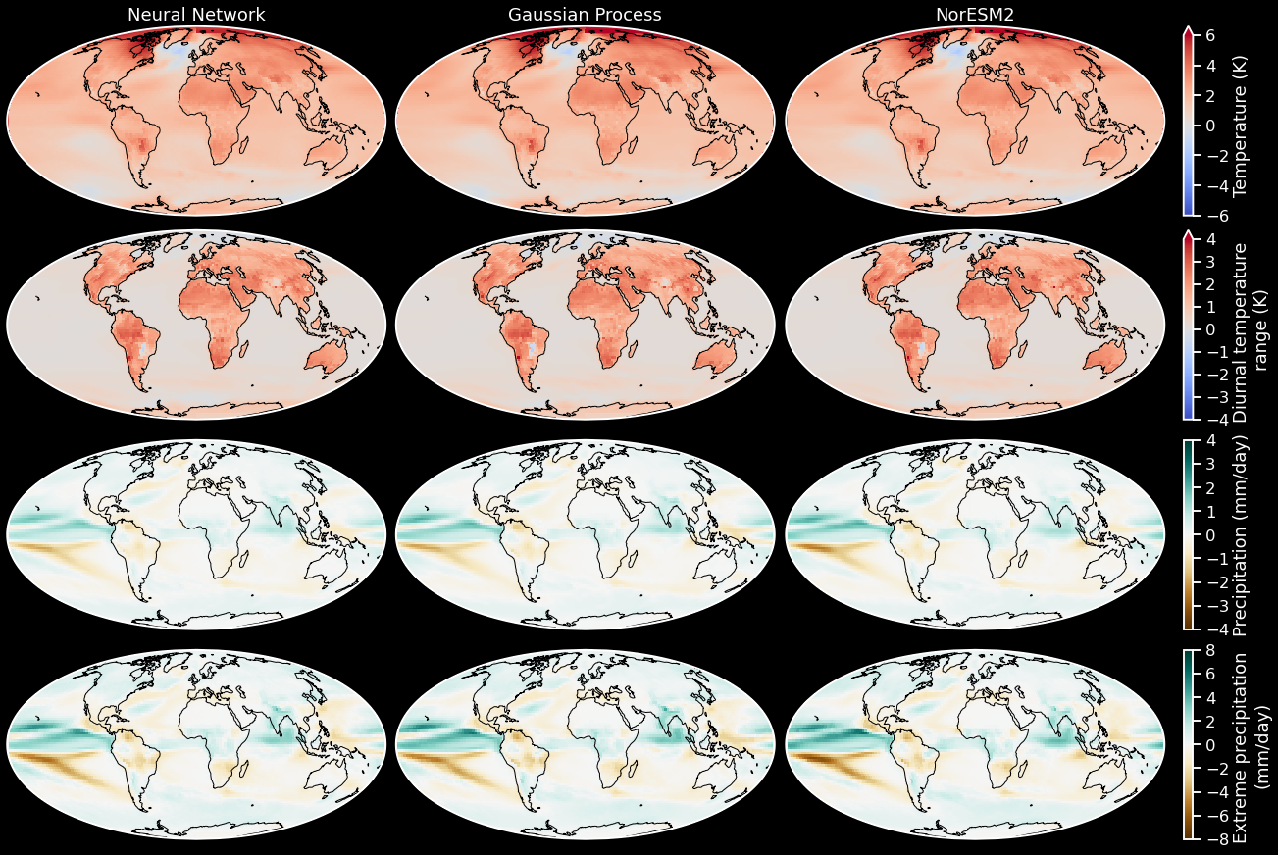
Baseline Models
Watson-Parris et al. JAMES (2022)

Slide 39
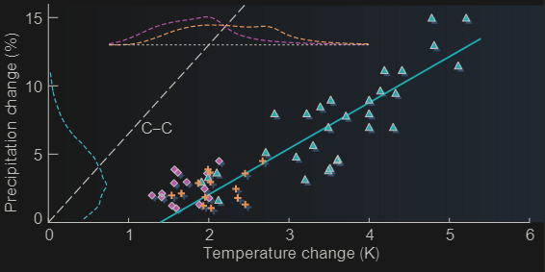
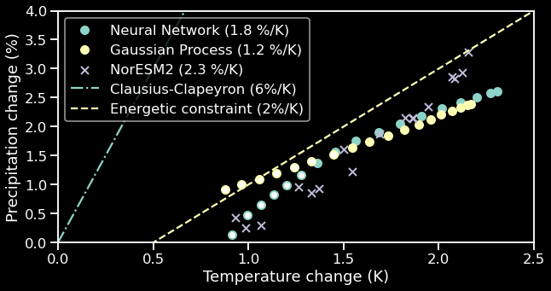

Global energy conservation
$$LΔP≅ΔR$$
Allen & Ingram 2002
Watson-Parris et al. JAMES (2022)

Slide 40

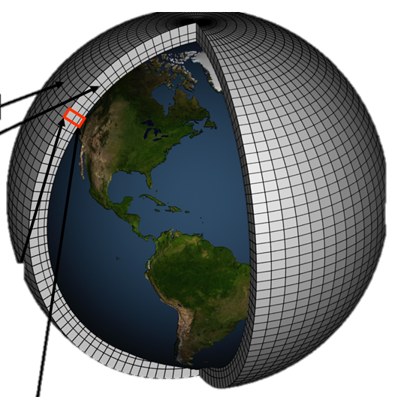
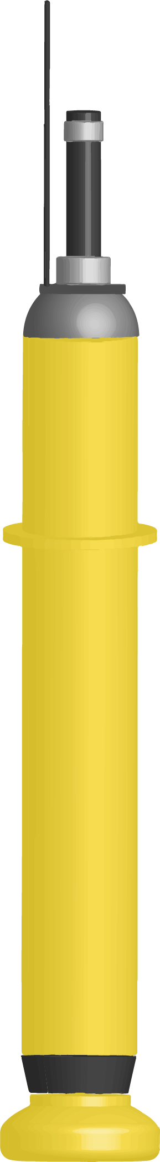
Energy Balance Models
$$\frac{dS_{i}(t)}{dt}=\frac{q_{j}F\left(t\right)−S_{i}(t)}{d_{i}}$$
$$q_{j}, F\left(t\right)$$
$$S_{i}, d_{i}$$
$$T\left(t\right)= \sum_{i}^{N}{S_{i}\left(t\right)}$$
Climate models
Measurements
Projections
Notes:
While climate models do perform these simulations they are rarely used directly.
For example, in the recent IPCC assessment, energy balance models (or SCMs) were used to determine the best estimates for different scenarios, and for linking to the impact assesments in WGII and II
These are based on physical understanding of the thermodynamic properties of the Earth as a whole
But they still have some key parameters which need to be provided by climate models ..
(such as)
and observations
(such as)
Si represents the temperature anomaly in box i with response timescale di at time t, F (t) is the effective radiative forcing, and T (t) is the global mean surface temperature anomaly
Qi are feedback parameters and di are thermal response parameters

Slide 41


A Physically Constrained Model
Shahine Bouabid
Take an ‘impulse response’ model (FaIR): $\frac{dS_{i}(t)}{dt}=\frac{q_{j}F\left(t\right)−S_{i}(t)}{d_{i}}$
The forcing takes an assumed structural form for each agent, e.g.:
$$F\left(t\right)=f_{log}\log\left(\frac{C\left(t\right)}{C_{0}}\right)+f_{lin}\left(C\left(t\right)−C_{0}\right)+f_{sqrt} \left(\sqrt{C(t)}+\sqrt{C_{0}}\right)$$
This empirical model is then fit to climate model output. Instead, we use this as the mean function of a Gaussian process model for more flexibility
This retains the original formulation where no data is present but provides a robust, Bayesian approach for adjusting it based on new data.
Importantly, the solution for $S_{i}(t)$ is also now a GP which automatically satisfies the above ODE, with well calibrated uncertainties!
Bouabid et al. arXiv:2307.10052
Notes:
We then have a physically constrained but expressive model for the temperature response – with well calibrated uncertainties.
We don’t show it here, but this can simply be extended to encode spatial variances as we did in the simple baseline GP.

Slide 42
A Physically Constrained Model
Following e.g., Hasselman 1976, we can also model temperature variability by introducing stochasticity in the forcing.
For example, by including a white noise term:
$\frac{dF}{dt}=−\frac{1}{τ_{F}}\left(F−F_{det}\left(t\right)\right)+\sqrt{\frac{2σ_{F}^{2}}{τ_{F}}}η\left(t\right)$.
For large $t$ the solution to this equation becomes a Gaussian process with exponential (or Matérn) covariance:
$$F\sim GP(F_{det},C_{1/2}^{τ_{F}, σ_{F}})$$
And, once again, the solution for heating is still a GP
So, we can quantify both model uncertainty and internal variability in our model, in combination and independently.
Bouabid et al. arXiv:2307.10052
Notes:
We then have a physically constrained but expressive model for the temperature response – with well calibrated uncertainties.
We don’t show it here, but this can simply be extended to encode spatial variances as we did in the simple baseline GP.

Slide 43
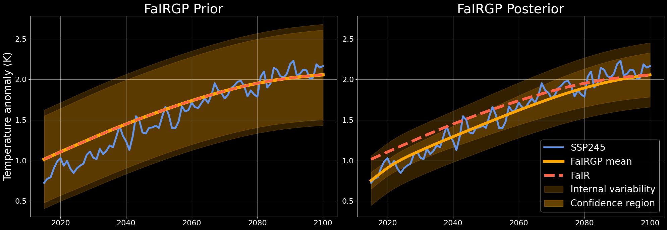
FaIRGP results (1D)
Bouabid et al. arXiv:2307.10052
Notes:
Already shows improved calibration in the simple 1D case for the Climate bench test scenario (middle of the road)

Slide 44
FaIRGP results (1D)
Bouabid et al. arXiv:2307.10052
Notes:
Already shows improved calibration in the simple 1D case for the Climate bench test scenario (middle of the road)

Slide 45
A Spatially Resolved, Physically Constrained Model
Pattern scaling provides a simple but effective spatial model:
$T\left(x,t\right)=β^{\left(x\right)}T(t) +β_{0}^{\left(x\right)}$.
The $β$ regression coefficients are typically obtained by fitting independent local linear regression models of global temperature locally.
If we substitute the deterministic temperature response with our GP version, we obtain a local FaIRGP prior temperature response:
$$T\left(x,t\right) \sim GP\left(β^{\left(x\right)}m_{T} +β_{0}^{\left(x\right)},{\left(β^{\left(x\right)}\right)}^{2}k_{T}\right)\text{.}$$
Which is still a GP…!
This can now be updated with local temperature observations to provide a posterior which encodes any observed deviation from linear scaling
Bouabid et al. arXiv:2307.10052
Notes:
We then have a physically constrained but expressive model for the temperature response – with well calibrated uncertainties.
We don’t show it here, but this can simply be extended to encode spatial variances as we did in the simple baseline GP.

Slide 46
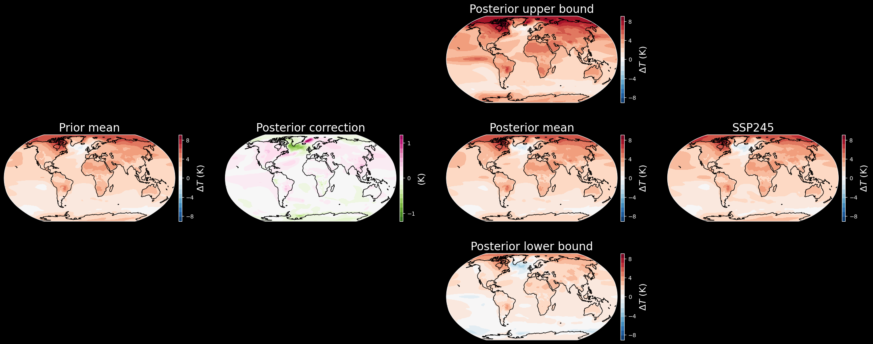
FaIRGP spatial results
Bouabid et al. arXiv:2307.10052
Notes:
Already shows improved calibration in the simple 1D case for the Climate bench test scenario (middle of the road)

Slide 47
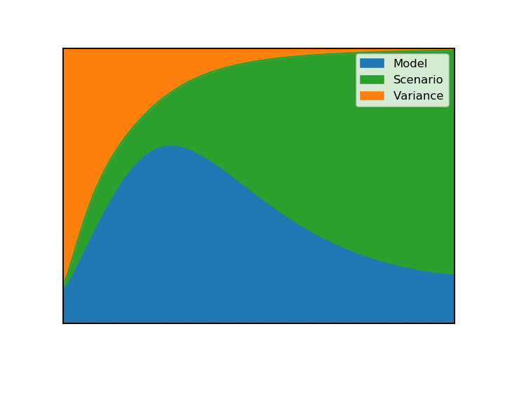
Sources of uncertainty
Watson-Parris 2021

Slide 48
Modelling spatio-temporal noise with Diffusion Models
Notes:
What if the structural parameterisation is just wrong though? Can we infer the response of clouds to aerosol directly from observations?
We can then use this improved physics knowledge to test and improve our parameterisations.
I don’t want to suggest replacing parameterisations with this I don’t think

Slide 49
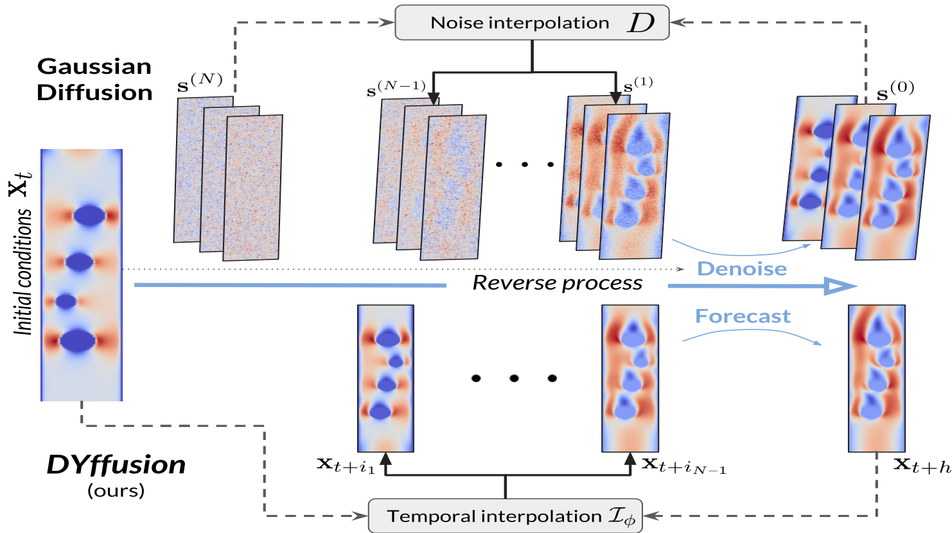
Modelling internal variability
Cachay et al. (submitted ICML)

Slide 50
Bringing it all together
Notes:
What if the structural parameterisation is just wrong though? Can we infer the response of clouds to aerosol directly from observations?
We can then use this improved physics knowledge to test and improve our parameterisations.
I don’t want to suggest replacing parameterisations with this I don’t think

Slide 51


Energy Balance Models
$$\frac{dS_{i}(t)}{dt}=\frac{q_{j}F\left(t\right)−S_{i}(t)}{d_{i}}$$
$$q_{j}, F\left(t\right)$$
$$S_{i}, d_{i}$$
$$T\left(t\right)= \sum_{i}^{N}{S_{i}\left(t\right)}$$
Climate models
Measurements
Projections
Notes:
While climate models do perform these simulations they are rarely used directly.
For example, in the recent IPCC assessment, energy balance models (or SCMs) were used to determine the best estimates for different scenarios, and for linking to the impact assesments in WGII and II
These are based on physical understanding of the thermodynamic properties of the Earth as a whole
But they still have some key parameters which need to be provided by climate models ..
(such as)
and observations
(such as)
Si represents the temperature anomaly in box i with response timescale di at time t, F (t) is the effective radiative forcing, and T (t) is the global mean surface temperature anomaly
Qi are feedback parameters and di are thermal response parameters

Slide 52
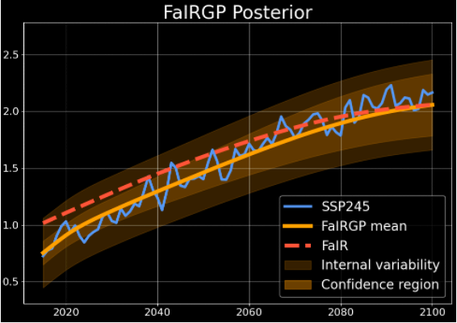


Closing the constraint loop
$$q_{j}, F\left(t\right)$$
$$S_{i}, d_{i}$$
Climate models
Measurements
Projections
Watson-Parris (in prep.)
Notes:
While climate models do perform these simulations they are rarely used directly.
For example, in the recent IPCC assessment, energy balance models (or SCMs) were used to determine the best estimates for different scenarios, and for linking to the impact assesments in WGII and II
These are based on physical understanding of the thermodynamic properties of the Earth as a whole
But they still have some key parameters which need to be provided by climate models ..
(such as)
and observations
(such as)
Si represents the temperature anomaly in box i with response timescale di at time t, F (t) is the effective radiative forcing, and T (t) is the global mean surface temperature anomaly
Qi are feedback parameters and di are thermal response parameters

Slide 53

Closing the constraint loop
$$q_{j}, F\left(t, θ\right)$$
$$S_{i}, d_{i}$$
Climate model PPE
Measurements
Projections
Watson-Parris (in prep.)
Notes:
While climate models do perform these simulations they are rarely used directly.
For example, in the recent IPCC assessment, energy balance models (or SCMs) were used to determine the best estimates for different scenarios, and for linking to the impact assesments in WGII and II
These are based on physical understanding of the thermodynamic properties of the Earth as a whole
But they still have some key parameters which need to be provided by climate models ..
(such as)
and observations
(such as)
Si represents the temperature anomaly in box i with response timescale di at time t, F (t) is the effective radiative forcing, and T (t) is the global mean surface temperature anomaly
Qi are feedback parameters and di are thermal response parameters

Slide 54
Closing the constraint loop
$$q_{j},F\left(t, θ\right)$$
$$S_{i}, d_{i}$$
Climate model PPE
Measurements
Projections
Watson-Parris (in prep.)
Notes:
While climate models do perform these simulations they are rarely used directly.
For example, in the recent IPCC assessment, energy balance models (or SCMs) were used to determine the best estimates for different scenarios, and for linking to the impact assesments in WGII and II
These are based on physical understanding of the thermodynamic properties of the Earth as a whole
But they still have some key parameters which need to be provided by climate models ..
(such as)
and observations
(such as)
Si represents the temperature anomaly in box i with response timescale di at time t, F (t) is the effective radiative forcing, and T (t) is the global mean surface temperature anomaly
Qi are feedback parameters and di are thermal response parameters

Slide 55
Closing the constraint loop
$$q_{j},F\left(t, θ\right)$$
$$S_{i}, d_{i}$$
Climate model PPE
Measurements
Watson-Parris (in prep.)
Notes:
While climate models do perform these simulations they are rarely used directly.
For example, in the recent IPCC assessment, energy balance models (or SCMs) were used to determine the best estimates for different scenarios, and for linking to the impact assesments in WGII and II
These are based on physical understanding of the thermodynamic properties of the Earth as a whole
But they still have some key parameters which need to be provided by climate models ..
(such as)
and observations
(such as)
Si represents the temperature anomaly in box i with response timescale di at time t, F (t) is the effective radiative forcing, and T (t) is the global mean surface temperature anomaly
Qi are feedback parameters and di are thermal response parameters

Slide 56
Summary
Machine learning can be harnessed to accelerate climate science
Such techniques are used to create Earth system model emulators for parameter estimation and constraining uncertainty
Similar emulators can be used for exploring scenario uncertainty with higher fidelity outputs and robust uncertainties
We have physical constraints on the (global) response, and these can be directly encoded using a physically-informed GP
Multi-model emulators will help explore and quantify the structural differences between models.

Slide 57
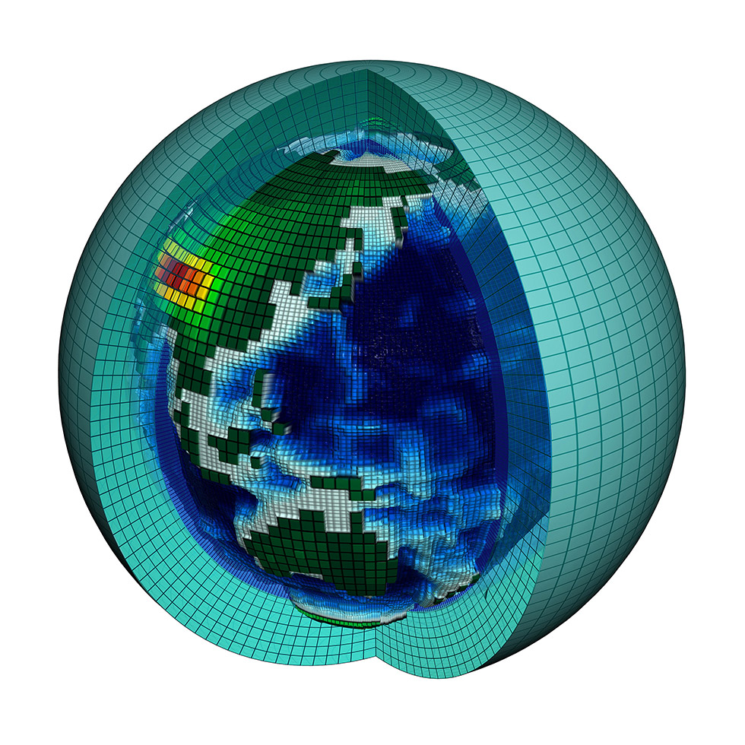
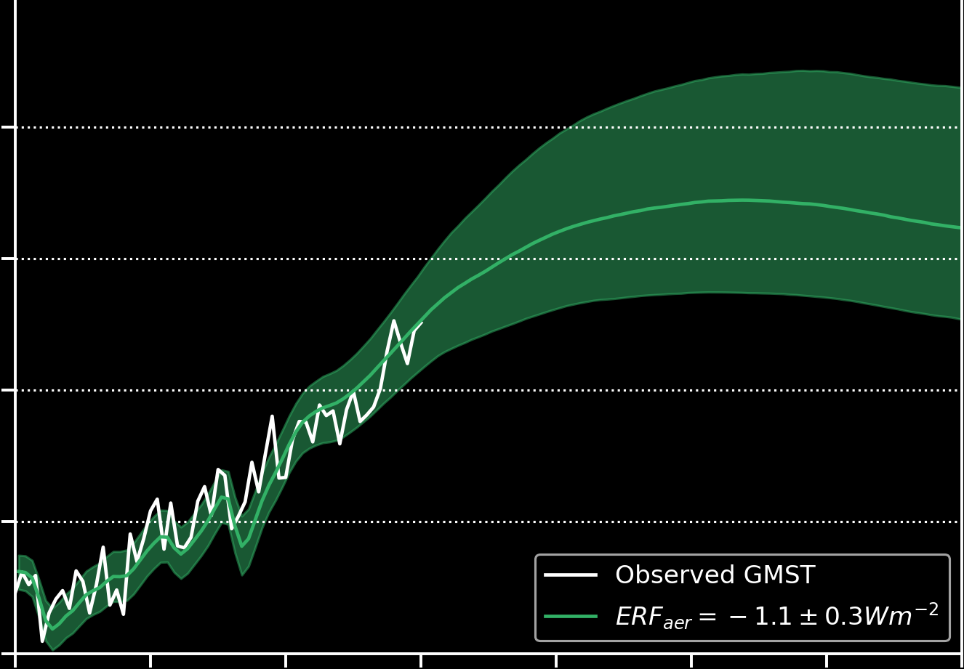
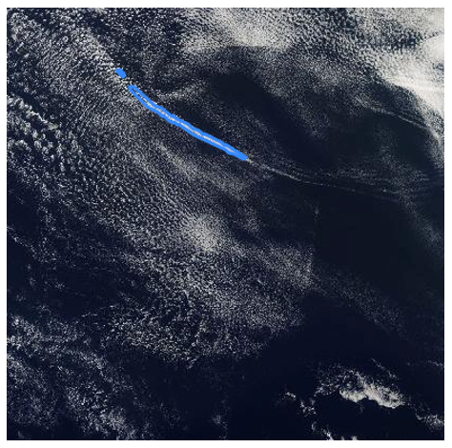
Climate Analytics Lab
Climate models
Energy balance models
Observations
e.g., Watson-Parris et al. JAMES (2022);
Watson-Parris & Smith Nat. Clim. Change (2022)
e.g., Watson-Parris et al. PNAS (2022); Watson-Parris et al. GRL (2021)
Energetic constraints
Process knowledge
duncanwp.github.io
Notes:
UN AI for good
Keen on broader collaborations

